Slide 1

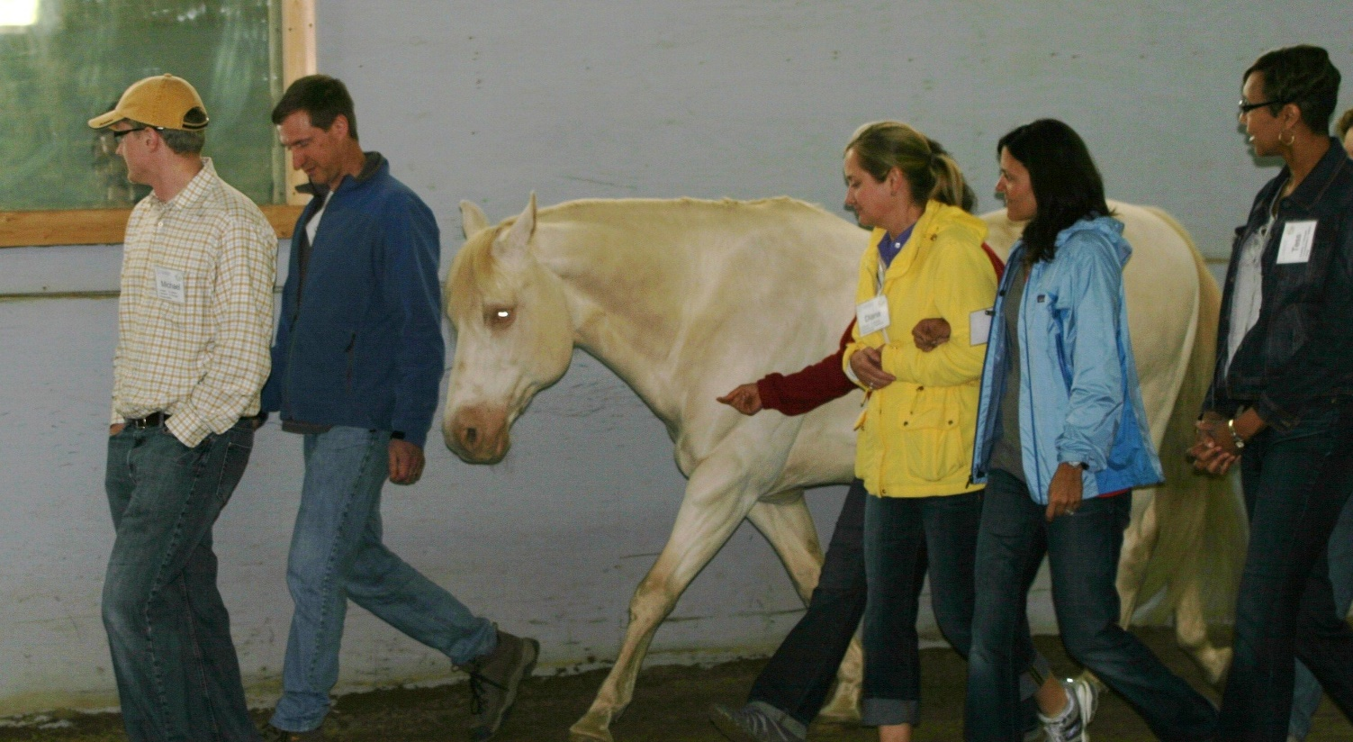
Optimal Terminology for Equine–Assisted Services Presented by Lissa Pohl, MA – Karin Bump, PhD NAEAA Conference May 29, 2024

Slide 2
Why Optimal Terminology?
To reduce confusion and better meet the needs of the following stakeholders:
Consumers – individuals, and organizations
Researchers – increasing the credibility of all Equine-assisted Services (EAS)
Service Providers – clarity about services offered and addressing liability
Service Funders – insurance and philanthropic funding

Slide 3
Consensus Building Process
Wood, Alm, Benjamin, Thomas, Anderson, Pohl & Kane (In press). Optimal terminology for services in the United States that incorporate horses to benefit people: A consensus document. Journal of Alternative & Complementary Medicine.
Notes:
To our knowledge, the consensus-building process is the most inclusive, sustained, systematic, and comprehensive effort yet to be undertaken in the United States to address problems of imprecise and unclear terminology pertaining to services that incorporate horses to benefit people. We are very pleased that this process has now culminated in a soon-to-be-published article that details all resulting terminology recommendations and their supporting rationales. The consensus-building process was inclusive, sustained, systematic and comprehensive because it followed these six progressive steps over a two-year period of time:
STEP ONE. In 2018, PATH International obtained funding from the Bob Woodruff Foundation to support the consensus-building process and convened a working group of five leaders (today’s panelists and authors on the article).
STEP TWO. The working group developed and distributed a national survey to ascertain how stakeholders perceived the relative usefulness of prominently used terms.
To develop the survey, the group assembled a comprehensive list of commonly used terms from websites of 17 relevant national organizations and from over 150 relevant books and peer-reviewed journal articles published since 1980.
16,156 online surveys were distributed to members of the American Hippotherapy Association, Inc., Equine Experiential Education Association (E3A), Eagala, Equus Foundation, and PATH Intl, in addition to approximately 500 recipients of services, their parents or caregivers. In total, 1,745 completed and useable surveys were returned and analyzed.
STEP THREE. Guided by survey findings, the working group planned a professionally facilitated two-and-a-half-day terminology summit.
Members of the working group plus ten other individuals with extensive experiences and perspectives participated in this summit.
By the summit’s conclusion, the group had produced an initial framework of recommendations.
STEPS FOUR, After the summit, the workgroup expanded to include an equine-assisted learning representative (Debbie Anderson and Lissa Pohl shared the role). The workgroup worked on the consensus document with ongoing feedback from the larger group as well as focus groups and boards comprised of individuals and boards involved in this work. during step four, and guided by the initial framework, the working group developed a first draft of recommendations. Other summit attendees approved this draft as suitable for further review by leaders and board members of the aforementioned organizations.
During step five, the working group considered all received reviews and finalized terminology recommendations accordingly.
During step six, the working group submitted final recommendations to other summit attendees for their approval or disapproval, and the Boards of Directors of national organizations involved in the consensus-building process, in addition to American Horse Council, Certified Horsemanship Association, and Horses and Humans Research Foundation. The final document was approved by 12 of the 14 summit members (with one abstention) and endorsed by five boards of major stakeholders.
Ultimately, this process culminated in widespread endorsement of recommendations to adopt specific optimal terminology and to discontinue uses of specific problematic terms.

Slide 4
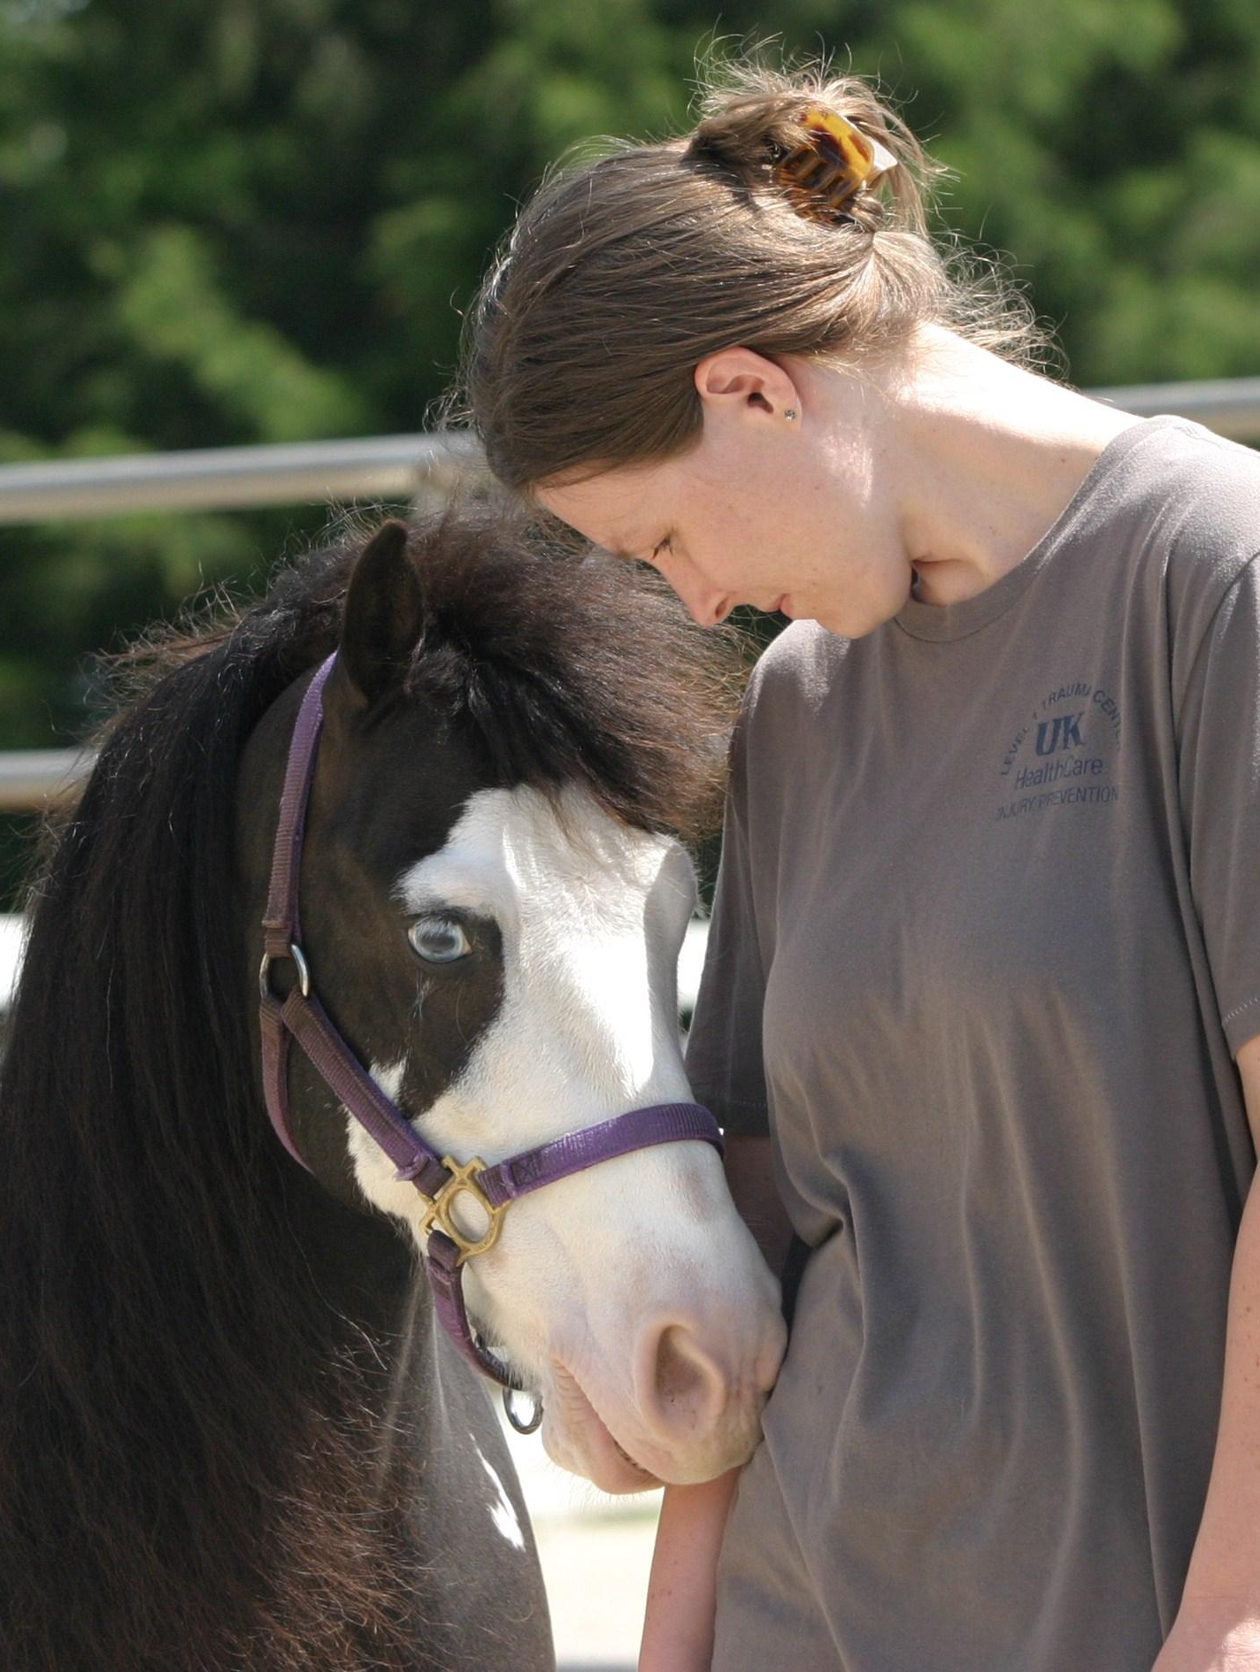
Optimal Terminology for Services in the United States That Incorporate Horses to Benefit People: A Consensus Document
Funded by the
Bob Woodruff Foundation
Published in the Journal for Alternative and Complementary Medicine, November 2020
Notes:
Equine-assisted services (EAS) is recommended as an optimal unifying term to refer to multiple services in which professionals incorporate horses and other equines to benefit people. Services refer to work done for, or on behalf of others. Unifying is defined in a manner that identifies the common thread that 12 otherwise different types of services share. Most contributors to the consensus-building process believed that this concise shorthand term was necessary both to refer to multiple services that incorporate horses and other equines, and to help diverse professionals who provide varied services collaborate, discuss, and resolve common issues. Furthermore, in the absence of recommending EAS, uses of alternative terms that have shown to be problematic would have continued usage. Optimal thus refers to the succinctness and accuracy of EAS, which was deemed superior to other terms. Lastly, EAS is intentionally plural because its function is to serve as an efficient shorthand for referring to at least two or more services.
Although any one distinct service constitutes a type of equine-assisted services, clarity and precision would require that this service be named and marketed, not as an equine-assisted service, but rather by using the most appropriate optimal terminology next presented (e.g., physical therapy, equine-assisted learning for organizations, driving).

Slide 5
Authors
Wendy Wood PhD. (ret.) Researcher CSU Temple Grandin Center
Kathy Alm CEO PATH Intl.
Joann Benjamin Physical Therapist American Hippotherapy Association
Lynn Thomas Horses for Mental Health, Arenas for Change
Debbie Anderson, Executive Director Strides to Success
Lissa Pohl, Univ. KY (formerly), Equine Experiential Education Association (E3A) Master Trainer, CEO The Engagement Quotient
Michele Kane, Veteran, PATH Intl. Certified Trainer

Slide 6
Why Unifying Term?
Equine-assisted Services
Equine-assisted Services (EAS) is a term used to refer to various services which professionals incorporate horses and other equines to benefit humans.
Equine-assisted Services is always used in the plural for ease in discussing multiple services, where the horse is the common thread.
EAS is not intended as an overarching term to imply all three areas fall under one industry or line of work.

Slide 7
Equine-Assisted Services Refers to multiple services in which professionals incorporate horses to benefit humans
THERAPY
LEARNING
HORSEMANSHIP
Counseling
Occupational Therapy
Physical Therapy
Psychotherapy
Speech-Language Pathology
Recreational Therapy
Equine-assisted Learning
in Education
Equine-assisted Learning
in Personal Development
Equine-assisted Learning
in Organizations
Adaptive Equestrian Sport
Adaptive Riding or
Therapeutic Riding
Driving
Interactive Vaulting
Equine-assisted Services
Wood W, Alm K, Benjamin J, Thomas L, Anderson D, Pohl L, Kane M. Optimal Terminology for Services in the United States That Incorporate Horses to Benefit People: A Consensus Document. J Altern Complement Med. 2021 Jan;27(1):88-95. doi: 10.1089/acm.2020.0415. Epub 2020 Nov 26. PMID: 33252244.

Slide 8
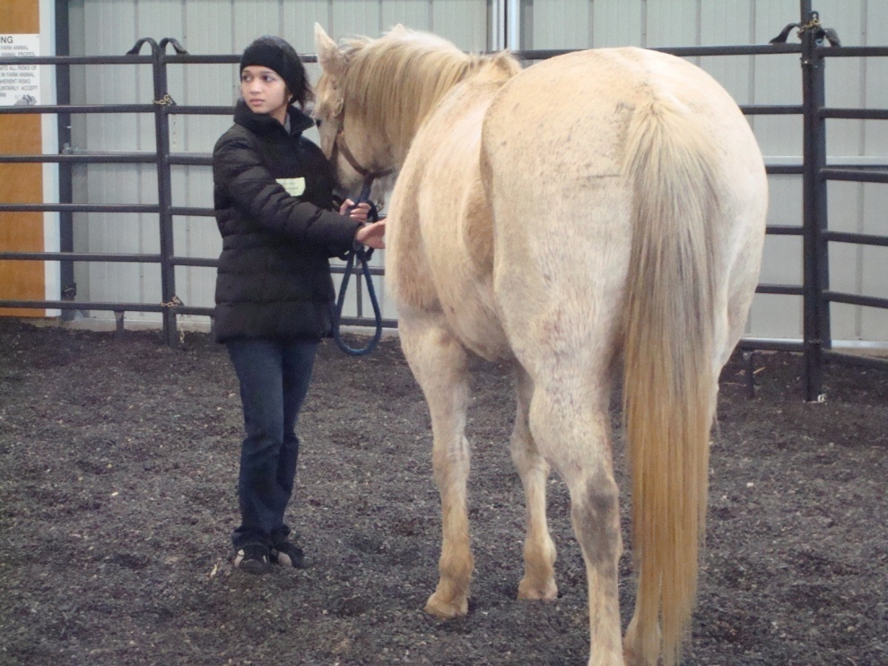
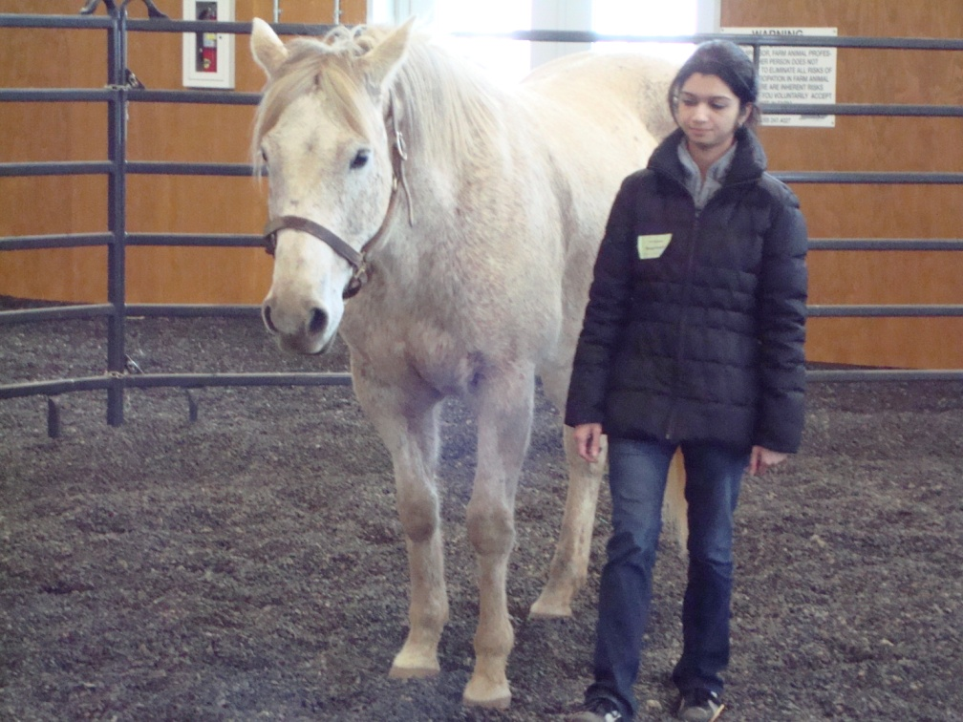
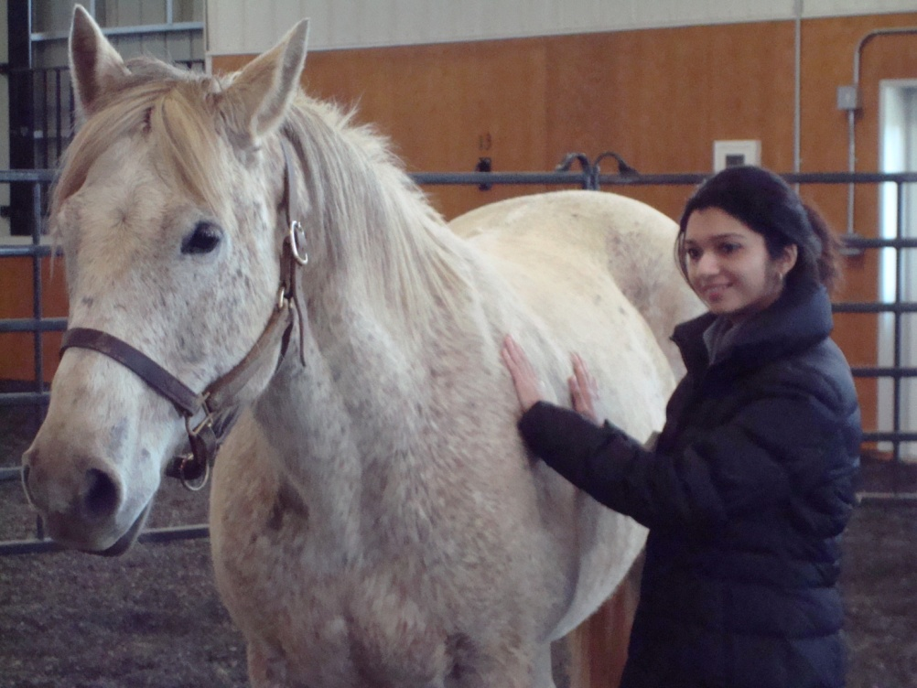
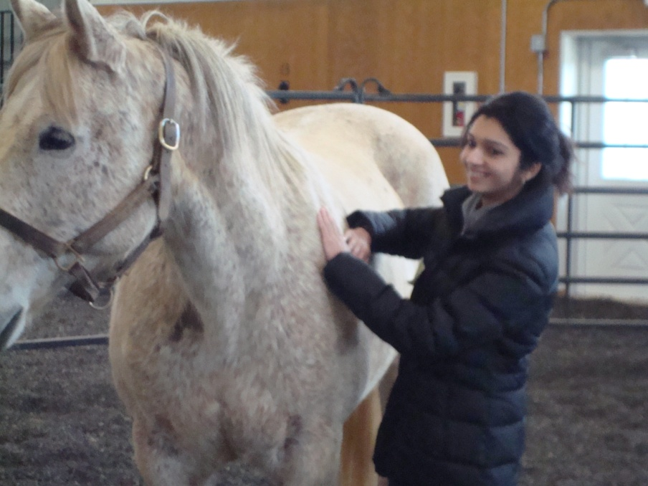
Therapy
Therapy is provided by licensed medical or behavioral professionals working within their scope of practice which may include:
Counseling
Occupational Therapy
Physical Therapy
Psychotherapy
Speech-Language Pathology
Therapy-first Language
When discussing therapy, indicate the therapy/therapist first followed by how the horse is included:
Physical therapy including equine movement
Counseling or psychotherapy with equine interactions
Notes:
The therapy area references services that are delivered by licensed therapy professionals within their scope of practice. Specific therapies, treatments or interventions may incorporate horses to address medical, cognitive, or behavioral health conditions as part of the individualized plan of care.
This section describes the value and importance of using therapy-first language, and to precisely identify the type of therapy being provided. Some examples, these are not limited to, may include: physical therapy using equine movement, psychotherapy incorporating horses, or occupational therapy in an equine environment.
Therapy first language clearly and accurately identifies that a professional therapy service is being provided and in which the choice to incorporate horses through their movement, environment or relationship, may be one part of an overall treatment plan. There is not a different stand-alone therapy involving horses. Referrals and billing are made to the professional therapy: namely counseling, occupational therapy, physical therapy, psychotherapy or speech-language pathology.

Slide 9
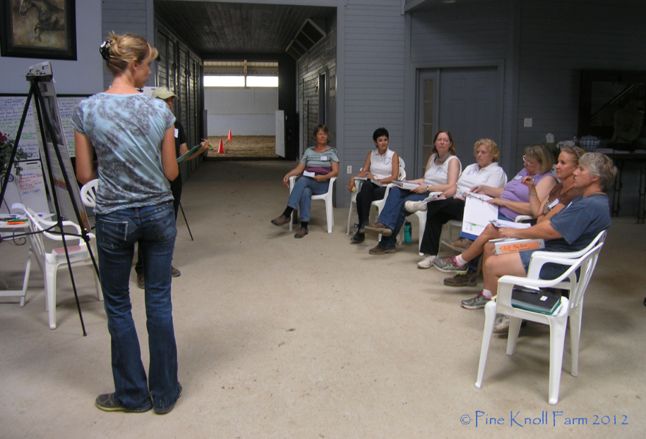
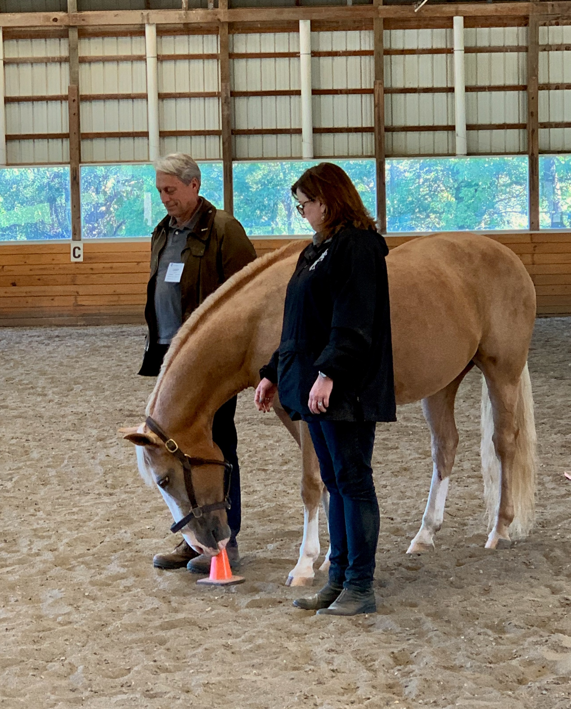
Equine-assisted Learning
This area is a non-therapy service comprised of equine-assisted services (EAL) in education, organizations and in personal development.
This type of experiential learning leverages interactive mounted and/or unmounted activities with horses and the equine environment to benefit participants.

Slide 10
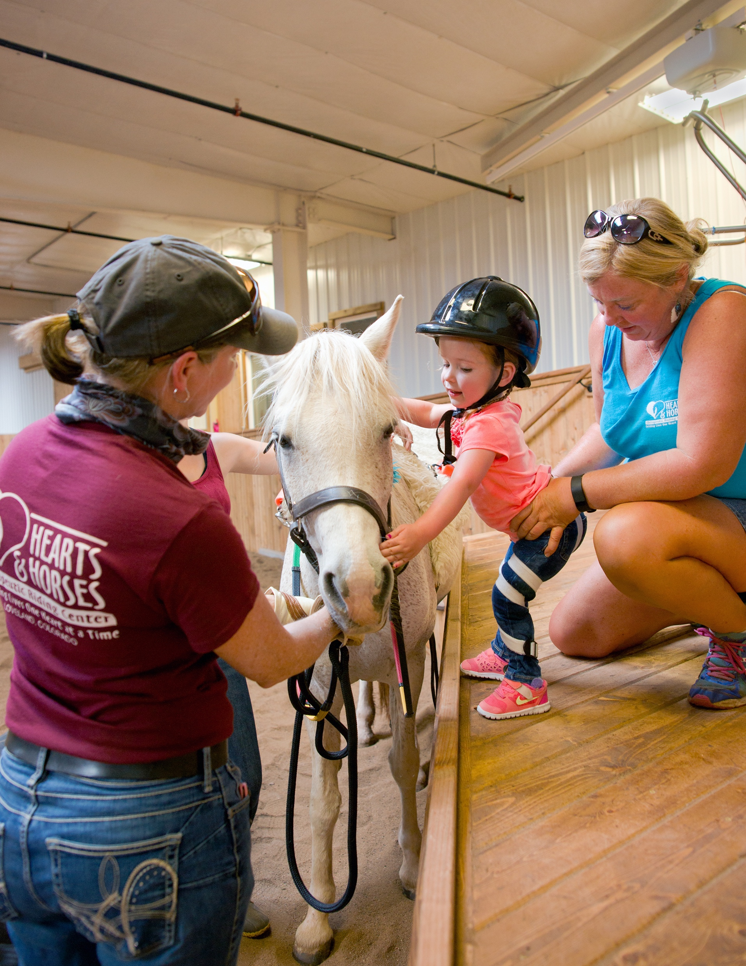
Horsemanship
An area of non-therapy services focused on various equestrian disciplines for individuals or
groups with diverse needs.
Therapeutic Riding/Adaptive Riding
Interactive Vaulting
Driving
Adaptive Equestrian Sports
Notes:
This area references non-therapy services delivered by specially trained or certified professionals whose primary area of expertise is in the discipline of horsemanship (including, but not limited to, riding instruction) in which the primary goal is to provide access to the benefits of horsemanship for individuals or groups with a variety of special needs, specific conditions, diagnoses, and/or disabilities.
These are: Therapeutic riding or Adaptive riding, interactive vaulting, driving, or adaptive equestrian sports.
There was much discussion about the terms therapeutic riding and adaptive riding. They appear to be used interchangeably by 50% of the survey respondents and those 50% that thought they were different didn’t significantly differentiate in the definitions they chose other than to show those that want to emphasize the natural therapeutic value of riding choose therapeutic riding and those that want to differentiate more clearly between therapy and riding activities choose Adaptive riding. Adaptive riding is a more recent term and consistent with terms in other adaptive sports whereas therapeutic riding is well-recognized and has been used in the US and internationally for more than half a century.

Slide 11
Terms Recommended for Discontinuation
Equine Therapy
Equine-assisted Activities and Therapies
Equine-assisted Therapy
Equestrian Therapy
Hippotherapist
Hippotherapy Program
Horse Therapy
Therapy Riding
Notes:
These terms were found to be problematic as they don’t specifically describe the type of service provided and contribute to the current confusion.
Equine therapy, Equestrian therapy and Horse therapy are especially problematic because it names something that doesn’t exist, is not specific to the type of service being provided

Slide 12
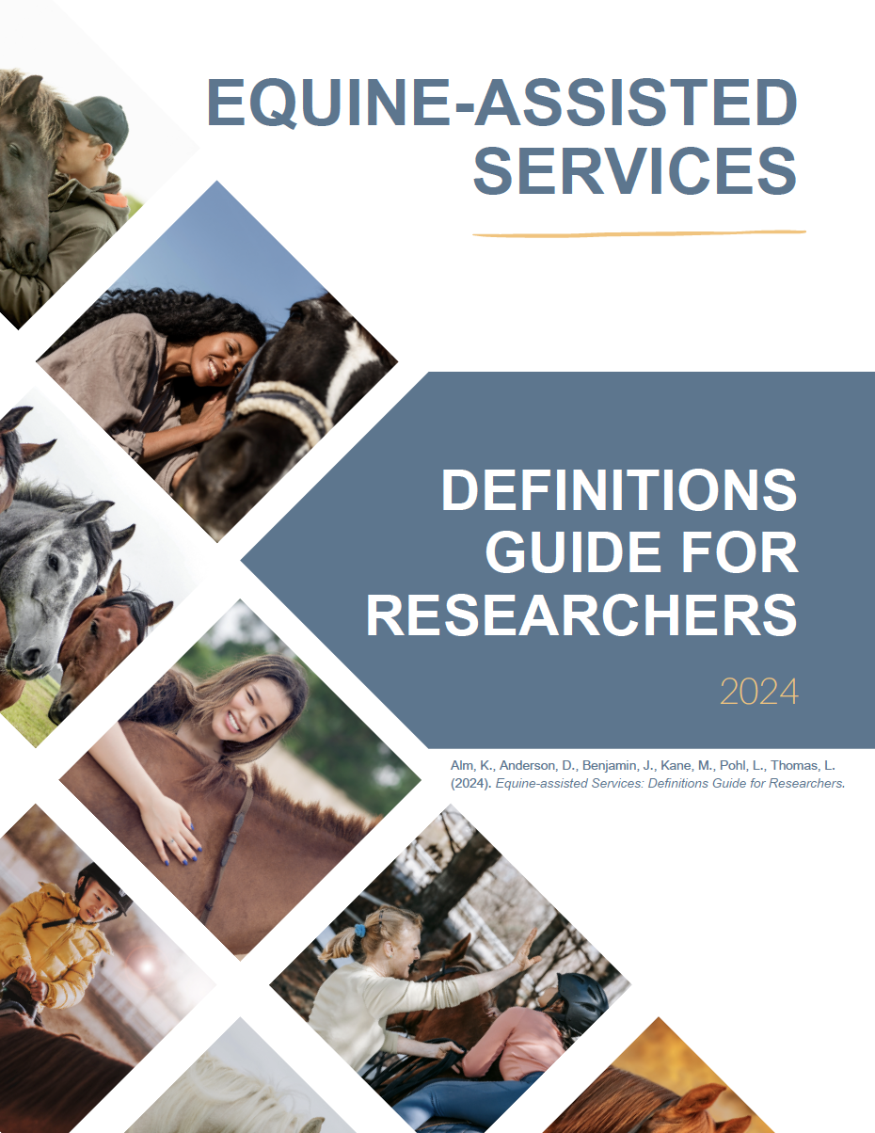
Questions & Discussion
Academia.edu

